Slide 1
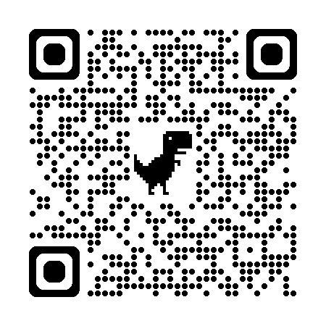
Eco-Matic Midterm Showcase
Eco-Matic Vending Machine
Console Application in C#
Conde · Sustainable Tech Midterm
Simple, data-backed walkthrough of our SDG-focused vending concept.

Slide 2
01
Project Overview
Purpose • Features • Audience • Stack
Purpose: Console-based vending machine that rewards recycling to help with the SDG’s.
Features: Dual customer/admin flows, CSV persistence, Spectre.Console dashboards, UTC logging.
Target Audience: Instructors, classmates, and sustainability advocates evaluating the concept.
Technology Stack: C# on .NET 9 with Spectre.Console, System.IO, and ANSI-styled output.
Project Overview
01

Slide 3
02
Requirements
Software • Installation • Hardware
Software: .NET 9 SDK, Spectre.Console package, and VS Code/VS 2022.
System: Any modern computer capable of running the .NET runtime
Requirements
02

Slide 4
03
File Handling Overview
Inventory • Event Log • Safeguards
Inventory CSV tracks slot type, name, price, stock, calories/volume.
Event log CSV chronicles purchases, recycle credits, and admin actions with timestamps.
Operations: load arrays on startup, rewrite inventory after edits, append log entries instantly.
Safeguards: Header validation, numeric checks, and auto-regeneration for missing files.
File Handling Overview
03

Slide 5
04
Code Structure
Classes • Methods • Modularity
EcoMatic coordinates menus, balance handling, inventory updates, and logging.
VendingItem base + Snack/Drink/Misc overrides deliver flavor text and CSV serialization.
Helpers (Write, TransactionTracker, RecycleTracker, SalesReport) isolate responsibilities / make
code more maintainable/readable.
Modularity: Constants define slot/stock limits to keep the single-file layout readable.
Code Structure
04

Slide 6
05
User Interface
Design • Input/Output • Flow
Spectre.Console tables and color-coded stock dots create a dashboard look.
Customer path: insert bills, examine items, buy items, recycle, receive change + receipt.
Admin path: password gate for restock, add/remove items, view/clear logs, run sales report.
User Interface
05

Slide 7
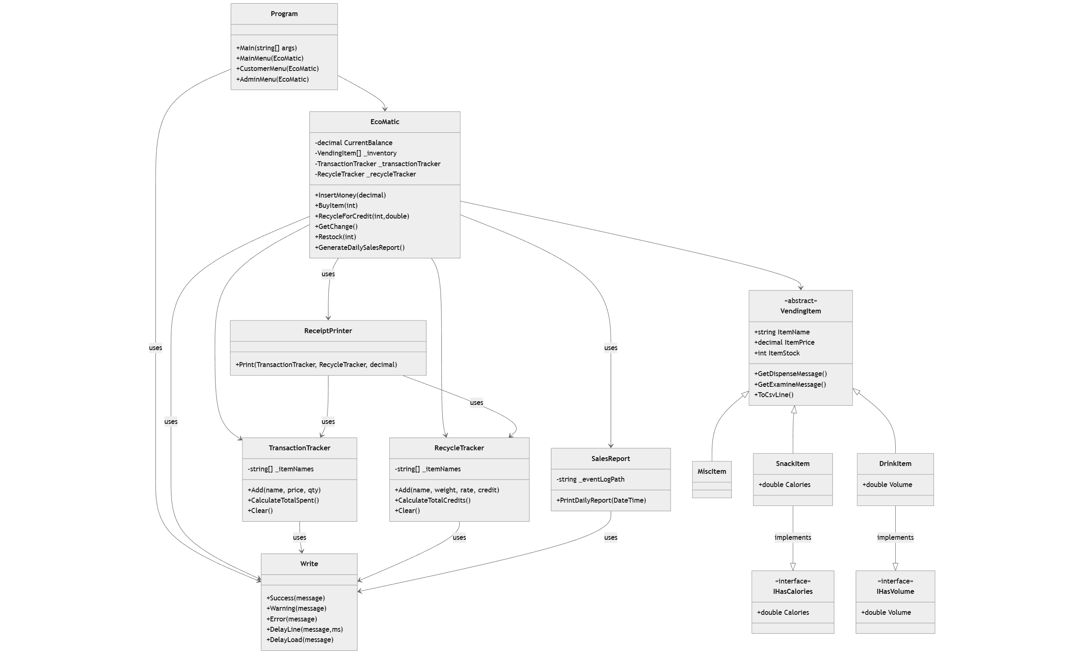

Slide 8
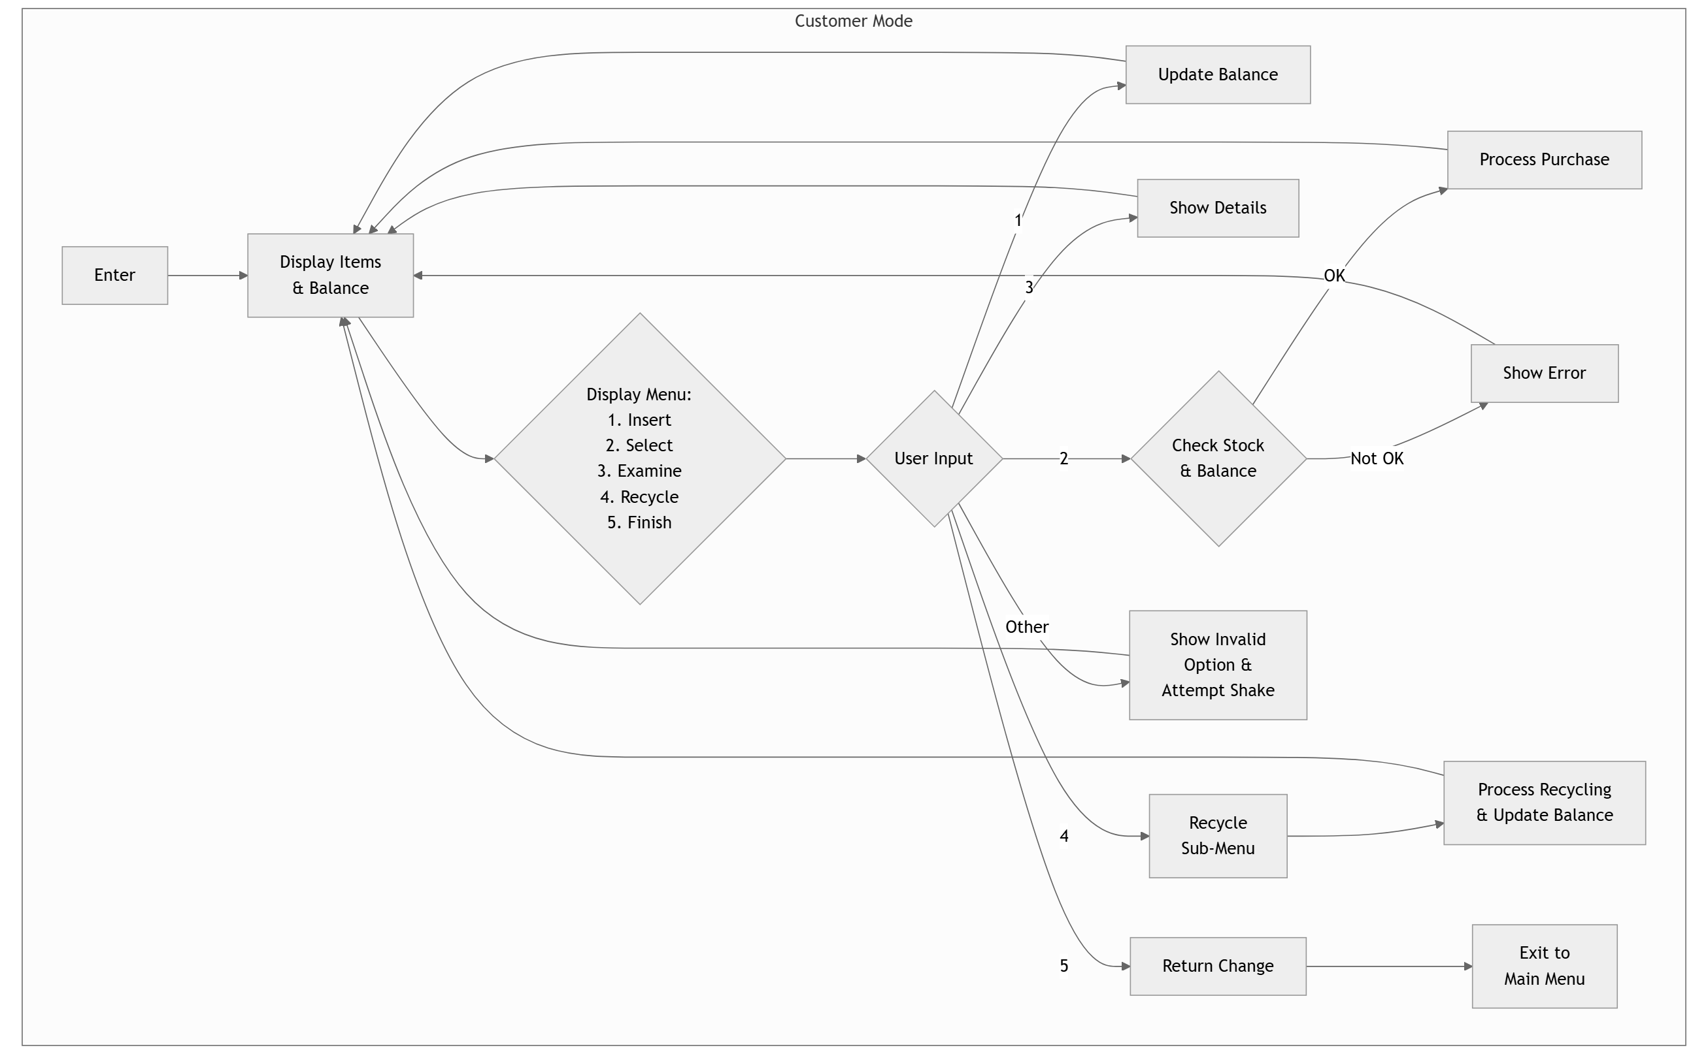

Slide 9
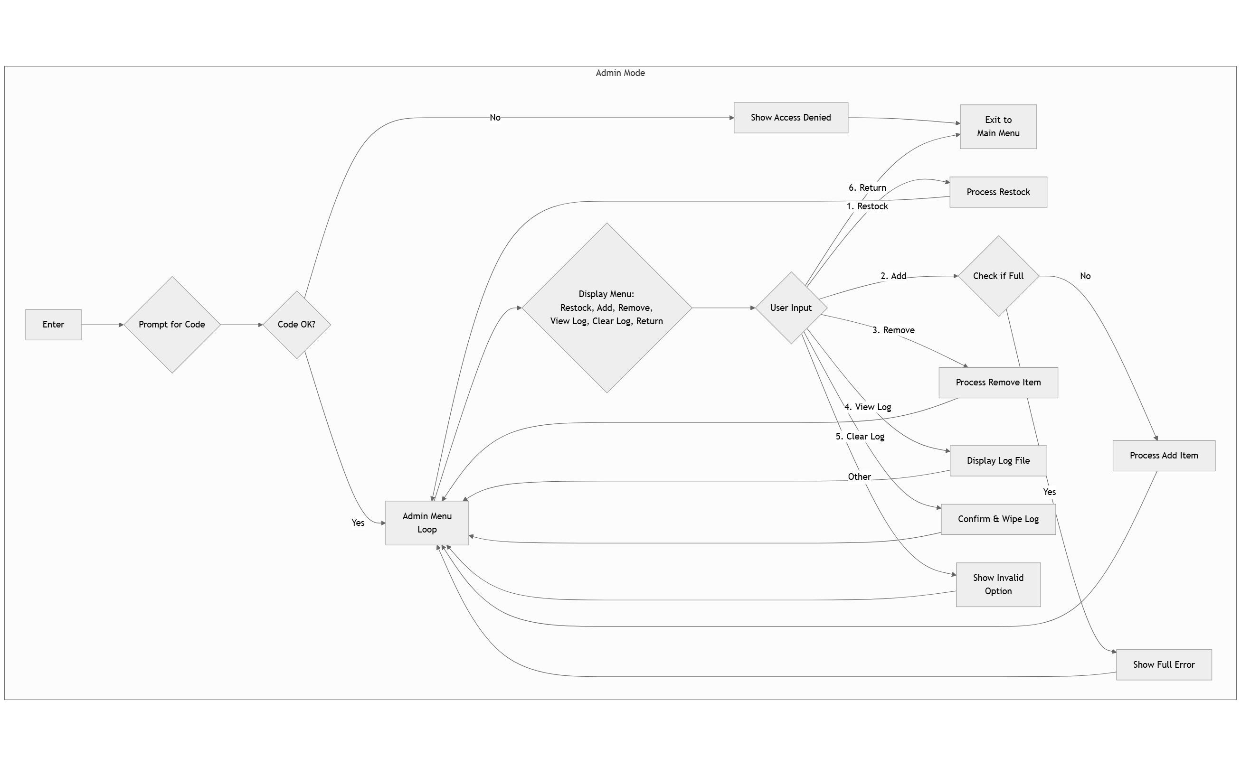

Slide 10
06
Challenges & Solutions
Development Hurdles
CSV integrity: validation + auto-rebuild routines prevent corruption.
Array constraints: trackers reset every session to avoid overflow and stale data.
Single-file: helper classes and regions keep logic modular despite the constraint.
Challenges & Solutions
06

Slide 11
07
Testing
Cases • Results • Limitations
Cases: normal purchases, insufficient funds, sold-out items, recycle bounds, admin tasks.
Testing
07

Slide 12
08
Future Enhancements
Planned Features • Performance
Refactor by splitting Program.cs and adopting collections for scalability.
Analytics: configurable recycle catalog plus multi-day dashboards.
UI: GUI
Future Enhancements
08

Slide 13
09
Conclusion
Reflection • Takeaways
This project deepen my knowledge on the concept of OOP
I also learned to implement file I/O in my program,
and improved my overall coding design.
Learned that sustainability developments can be solved through technical ways.
Conclusion
09

Slide 14
10
Appendix
Source Code & References
Source Code
https://github.com/SeanixReal/Eco-Matic
References
Spectre.Console https://spectreconsole.net/ .NET documentation for file handling and console APIs. https://learn.microsoft.com/en-us/dotnet/
SDG inspiring the recycle-for-credit concept. https://sdgs.un.org/goals
Appendix
10

